Slide 1


Quantile Regression on SAT score
Young Seok Seo

Slide 2
Problem
Education is still one of the most important factor regardless of Pandemic
How each factor impacts on average SAT score of NYC High School at each quantile
Results can be independent by different test, city or country.

Slide 3

Quantile Regression
OLS
‘$y_{i} = x_{i}^{′}β + ε_{i}$
$ε_{i}$ ~ N(0,$σ^{2}$)
$$\breve{β}=\min{Σ(y_{i}−x_{i}^{′}{β)}^{2}}$$
Quantile Regression
𝑄𝜏(𝑦𝑖|𝑥𝑖)=𝑥𝑖′𝛽𝜏
𝛽̂𝜏 =𝑚𝑖𝑛 Σ𝜌𝜏(𝑦𝑖−𝑥𝑖′𝛽𝜏)
𝜌𝜏=τ𝑥 𝐼(𝑥>0)+(τ−1) 𝑥 𝐼(𝑥𝑛<0)
𝑄̂𝜏(𝑦𝑡|𝑥𝑡)=𝑥𝑡′𝛽𝜏

Slide 4
Why Quantile Regression
More robust against outliers in the response measurements
When outside of the mean of the data is interesting
Non-normally distributed
Non-linear relationships
Notes:
Understanding relationships between variables outside of the mean of the data, when conditional quantile functions are of interest

Slide 5
Data
Total 363 High Schools in NYC
14 Independent variables
SAT_Score
Number of Exams with scores 3 4 or 5 | saf_s_11 | AVERAGE CLASS SIZE
total_enrollment | ell_percent | asian_per
black_per | white_per | hispanic_per
male_per | female_per | school_dist

Slide 6
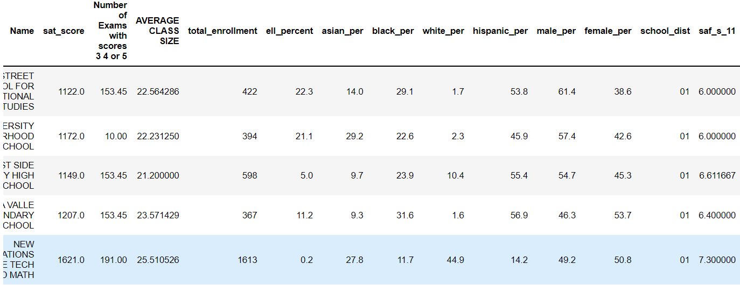

Slide 7
Analysis
Normally distributed in [−1σ,1σ].
Skewed to the right
Outliers
→ Quantile Regression

Slide 8
Notes:
Fig 3. Number of Exams with Scores does not affects on SAT score before 90th quantile
Fig 4. Avg.Class.Size does not influence on sat score except for extreme quantile
Fig 5. Influence of Total Enrollment increase
Fig 6. No Influence of English Learner Percentage on SAT score except for extreme quantile at right side

Slide 9
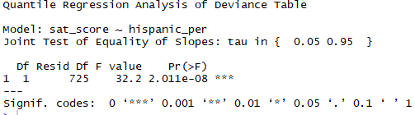
Notes:
Fig 7 : Asian Percentage affects on SAT score at high school
Fit

Slide 10
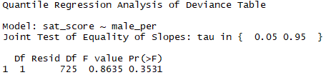
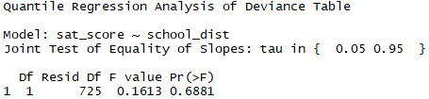
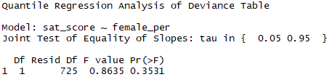
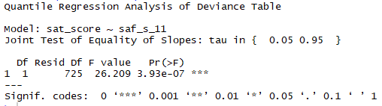
Notes:
Fig 7 : Asian Percentage affects on SAT score at high school
Fit

Slide 11


Coefficients of Beta in Quantile Regression

Slide 12
Conclusion
Positive |  | Negative
Number of scores 3.4 or 5 on AP Test | Gender | English Leaner %
Average Class Size of school | Location | Black
Total Enrollment |  | Hispanic
Asian
White
safety level

